Slide 1
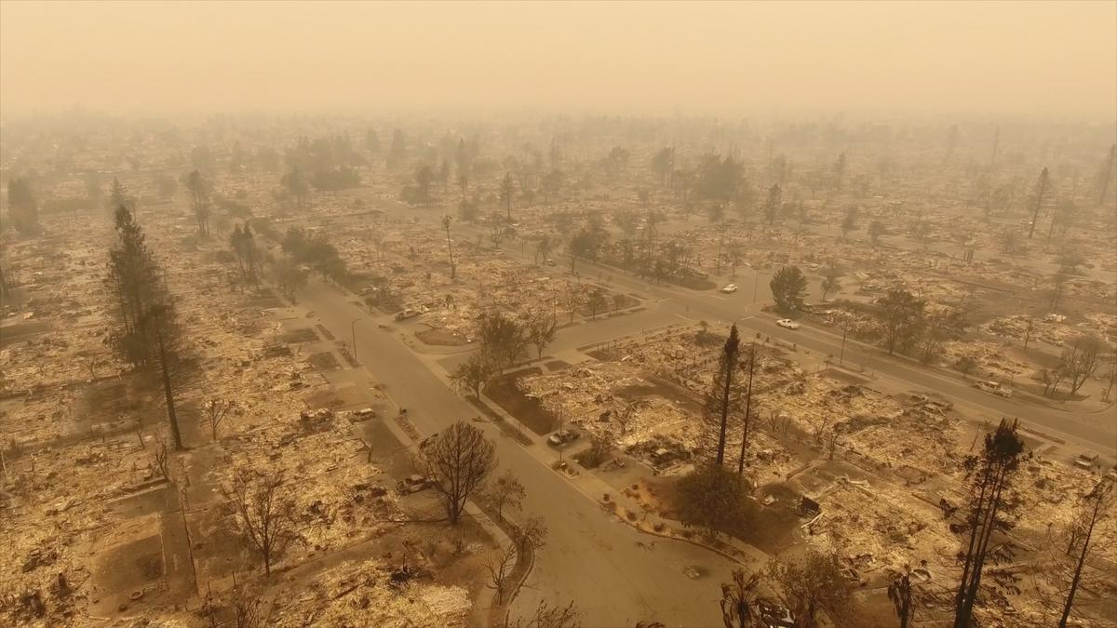
Sonoma County
Wildfire Risk Analysis
Final Project Presentation
Spring 2020, CMPE257-Session22 Group2
Afra Bijli 008340631 afra.bijli@sjsu.edu
(Ginny) Jeehee Choi 012565696 jeehee.choi@sjsu.edu
Ililta Gebrihiwet 013828048 ililta.gebrihiwet@sjsu.edu
Sukriti Mishra 014580696 sukriti.mishra@sjsu.edu
Sunanda Das Suchi 013866684 sunandadas.suchi@sjsu.edu
Notes:
My team chose “sonoma county wildfire risk anlaysis” as our project. Team members are Afra, Ginny, Ililta, Sukriti, and Sunanda. (10sec)

Slide 2
Overview:
Project introduction
Project team
Training/ testing dataset, preprocessing
Machine Learning models
Experimental Results
Comparison of Experimental Results of Models
Notes:
This is the overview of our presentation. (Read above) (15sec)

Slide 3
Project Introduction
Motivation: Wildfire seasons are becoming longer and more unpredictable in many parts of the world. Therefore, this machine learning algorithm applied risk analysis will assist predicting wildfire risk in Sonoma County, CA.
Objective: To analyze Sonoma County’s wildfire risk using fire history, weather, NDVI, human factor datasets
Project needs:
(1) Collection of datasets such as fire history, weather, NDVI, human factor datasets
(2) Selection of different ML models according to the attributes and its impacts on wildfires, and then implementation of selected models and AI algorithms on the collected datasets
(3) Comparative studies of different models on the basis of accuracy percentage to determine which model is best for the risk prediction of wildfires occurrence
Notes:
This is the motivation, objective, and project needs of our project. (5 sec)
The motivation of our project is that Wildfire seasons are becoming longer and more unpredictable so this machine learning algorithm applied risk analysis will assist predicting wildfire risk in Sonoma County. Our objective is To analyze Sonoma County’s wildfire risk using several datasets.
Project needs are the collection of datasets, Selection and implementation of different ML models according to the attributes and its impacts on wildfires, then Comparative studies of different models on the basis of accuracy percentage (35sec)

Slide 4
Project Team
Responsibility | Team Member Contribution
Data Preparation | All
Data Preprocessing | All
Data Visualization | All
Random Forest Classifier (Fire history & Weather) | Afra Bijli
Logistic Regression (Fire history & Weather) | (Ginny) Jeehee Choi
KNN (Fire history & NDVI) | Sunanda Das Suchi
Support Vector Machine (Fire history & NDVI) | Sukriti Mishra
Logistic Regression ( Human factors) | Ililta Gebrihiwet
Notes:
This is our team organization tasks and roles. (4sec)

Slide 5
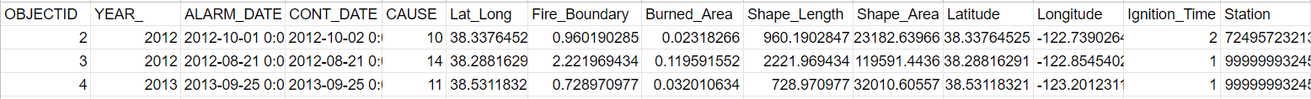
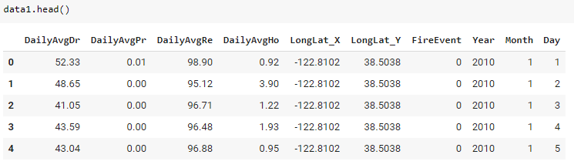
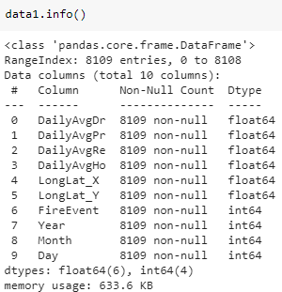

Fire History Data
Fire History Data
Data types: integer, float, date, text
Parameters: Burned_Area (km2), Lat_Long (latitude, longitude),
Ignition_Time (day), Fire Boundary (km), Cause, Year, Alarm_date, Containment_date, WeatherStation
-------------------------------------------------------------------------------Dataset is from: The Fire and Resource Assessment Program’s
Fire Perimeters dataset
Training data: 6,080
Test data: 2,027
Dataset size: 81,090
Filtered and merged fire history data with weather data
within Sonoma County & fire event after 2010.
Notes:
The Datasets are acquired from the fire and resource assessment program. The parameters of fire history data are Burned_Area (km2), Lat_Long (latitude, longitude), Ignition_Time (day), Fire Boundary (km), Cause, Year, Alarm_date, Containment_date, and WeatherStation. With the integration of weather dataset, the total number of fire and weather training data is about 6000 and test dataset is 2000. Fire history data and weather data are merged as a one dataset based on the date and location of weather station and fire occurred location.
(40sec)

Slide 6
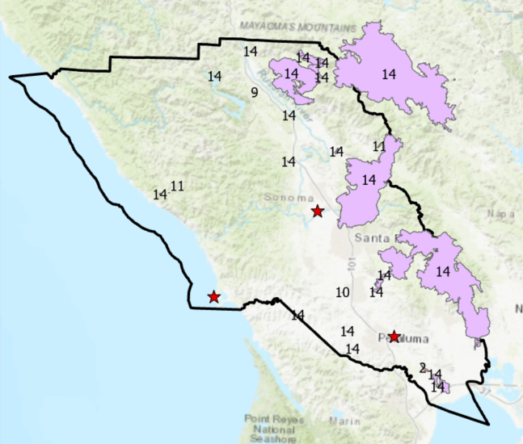
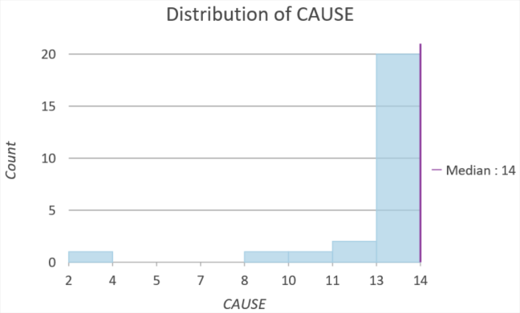
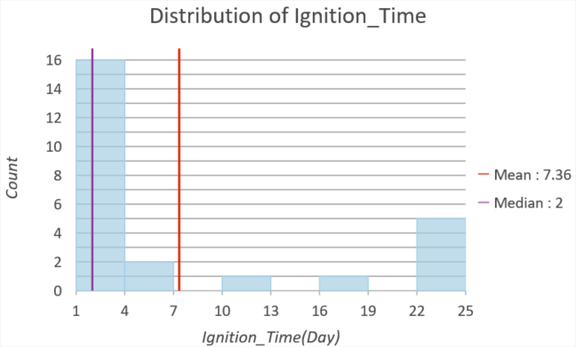
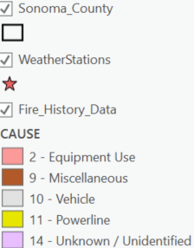
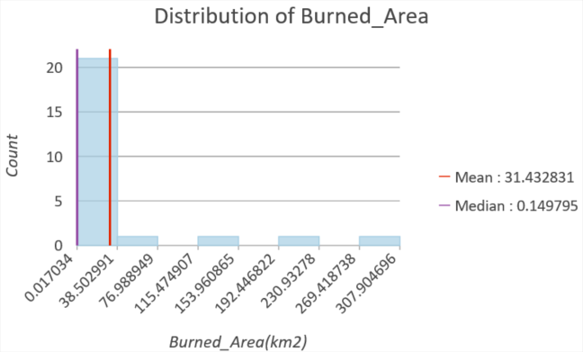
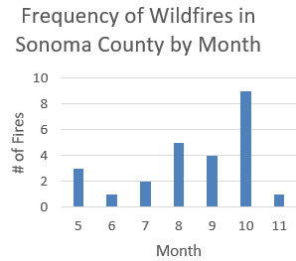
Fire History Data
Notes:
The left hand side shows sonoma county with fire history data. The different color and number indicates each cause of fire. The red stars indicate weather stations.
While 19 types of fire causes are available in options, only 5 types are the cause in Sonoma County. The main cause of fire in sonoma county is unknown or unidentified with 20 occurrences for the past 10 years. The average fire ignition time is 7.4 days and median is 2 days. The average burned area is 31 km2 and median is 0.15 km2. Fire is most frequently occurred between August to October. (42sec)

Slide 7
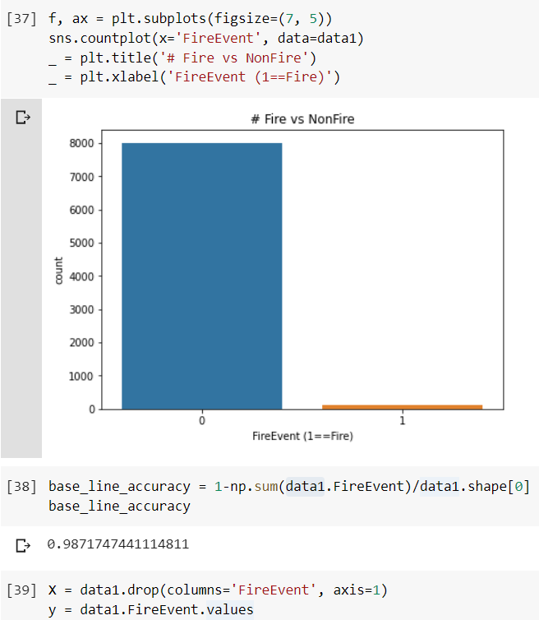
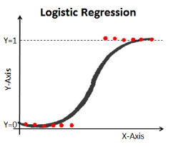
Fire History - Logistic Regression
Notes:
Justification: I chose binary logistic regression because the dependent variables are categorical and explanatory variables can take any form. Also, Linear combination of parameters B(beta) and the input vector are incredibly easy to compute.
Using the train test split function, the datasets are divided into 80:20 ratio. The training data’s accuracy rate is 98.7% with AUC(Area under the ROC(Receiver-Operator-Curve) )) rate 91.4%. The test data’s accuracy is 98.5% with AUC rate 92.2%. The f1 score is 97.7%.
(55sec)

Slide 8
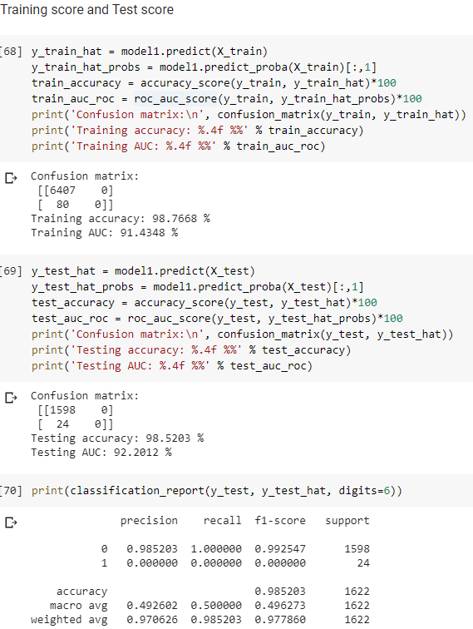
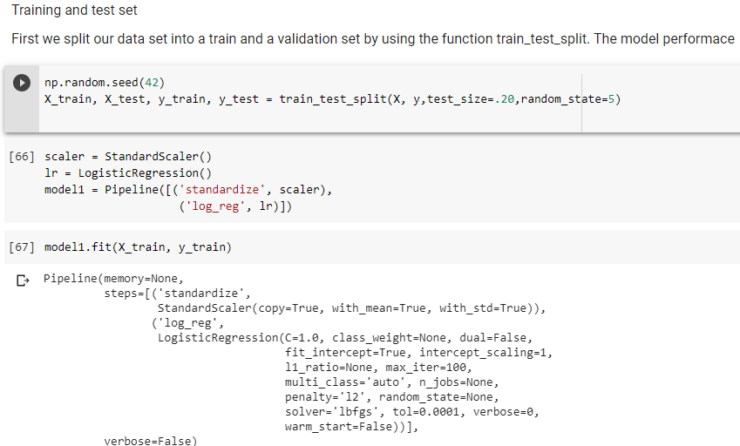
Fire History - Logistic Regression
Notes:
Justification: I chose binary logistic regression because the dependent variables are categorical and explanatory variables can take any form. Also, Linear combination of parameters B(beta) and the input vector are incredibly easy to compute.
Using the train test split function, the datasets are divided into 80:20 ratio. The training data’s accuracy rate is 98.7% with AUC(Area under the ROC(Receiver-Operator-Curve) )) rate 91.4%. The test data’s accuracy is 98.5% with AUC rate 92.2%. The f1 score is 97.7%.
(55sec)

Slide 9
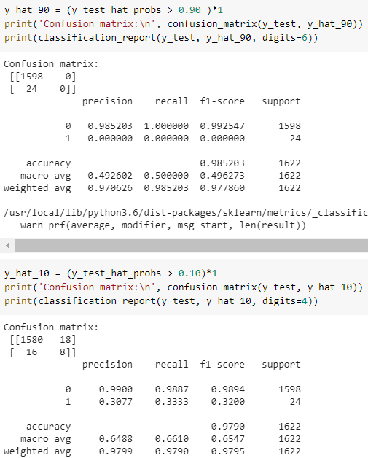
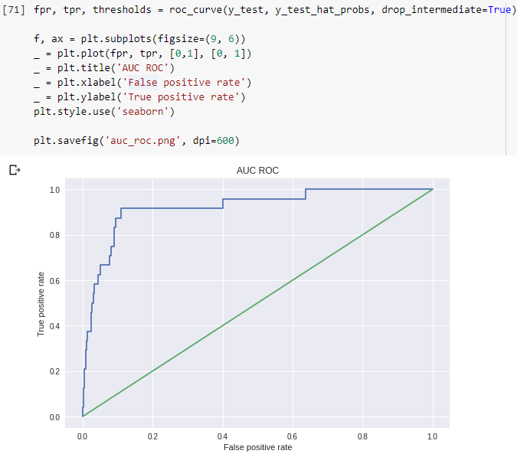
Fire History - Logistic Regression
Notes:
To visualize the Receiver-Operator-Curve I used the function roc_curve. The method returns the true positive rate (recall) and the false positive rate (probability for a false alarm) for a bunch of different thresholds. This curve shows the trade-off between recall (detect fire) and false alarm probability.
This model classify all weather data attributes with a fire probability of 50% as fire.
I set the threshold to 90% the recall is 0%. while the false positive rate is the same.
When the threshold is down to 10%, around 33% of all fire case are detected but false positive rate doubles with 18 false alarms.
(47sec)
AUC (Area under the ROC Curve)

Slide 10
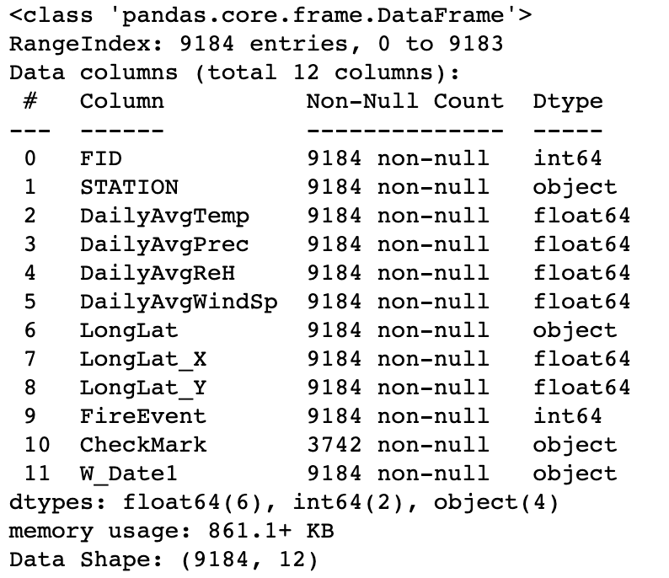
Weather - Random Forest Classifier (RFC)
Data Collection & Source
Hourly weather data was retrieved from 3 weather stations across Sonoma County from the NOAA, Climate Data Online, Climatology website: https://www.ncdc.noaa.gov/cdo-web/
Information on Wth-Fr Dataset: Parameters, Data Type, Total Number of Records
WBAN Station ID | Station | Date Range
23213 | SANTA ROSA SONOMA CO AIRPORT, CA US | January 1st, 2010 - December 31st, 2019
0032 | PETALUMA MUNICIPAL AIRPORT, CA US | July 31st, 2014 – Dec 31st, 2019 (No data before July 31st, 2014)
93245 | BODEGA 6 WSW, CA US | January 1st, 2010 - December 31st, 2019
Training and Test Data Sizes (67:33 split)
Parameters: DailyAvgTemp, DailyAvgPrec, DailyAvgReH, DailyAvgWindSp
Data Types: float, int, object
Total # of Records: 9184
Training Data Size | Test Data Size
6153 | 3031
Notes:
Random Forest Classifier (RFC) on Fire History & Weather Data
This weather dataset has been obtained from the NOAA, Climate Data Online, Climatology website: https://www.ncdc.noaa.gov/cdo-web/

Slide 11
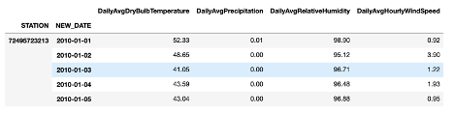
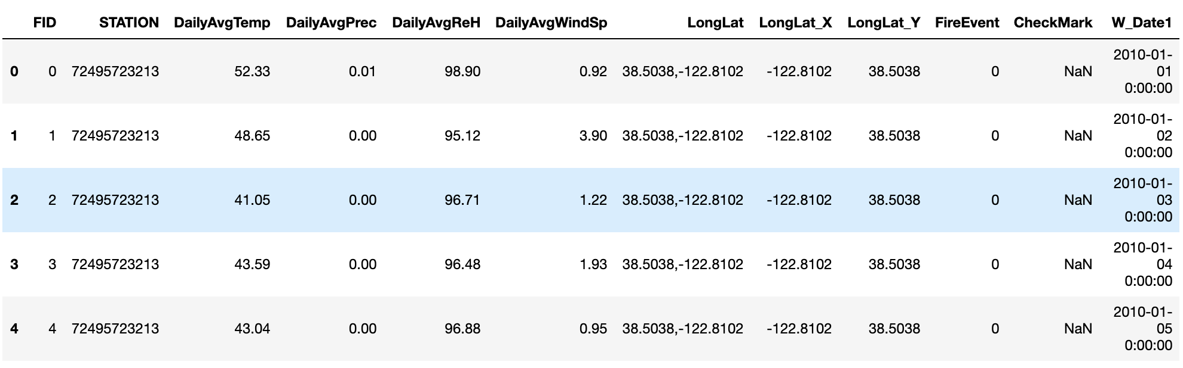
Weather - Random Forest Classifier (RFC)
Pre-processing of Dataset
Feature engineering/selection
Imputation of missing data values
Merging and aggregating weather datasets together
Merging weather dataset and fire history dataset together
Model Selection and Justification-Random Forest Classifier (RFC) is an ensemble learning method based on classification
Collection of many decision trees “randomly selected subset of training set.
It aggregates the votes from different decision trees to decide the final class of the test object” and hence is also referred to bootstrap aggregation or bagging technique.
Figure 1 for resulting dataframe after preprocessing step# 3
Figure 2 above of a sample snippet of the final weather- fire history dataset after completing all data cleansing steps above and how it is organized (after preprocessing step #4)
Notes:
Model Selection + Justification
Goal: build a classifier to accurately predict the probability of a fire based on weather conditions like temperature, humidity, precipitation, and wind speed and fire history. Output of model: binary classification of results (1 = Fire & 0 = No Fire)
FireEvents = 0 (No Fire): 9080 cases
FireEvents = 1 (Fire): 104 cases
Bagging is a technique to reduce variance of model with high-variance, such as DTs. Bagging is used to reduce the complexity of the models that overfit the training data (high variance and low bias)

Slide 12
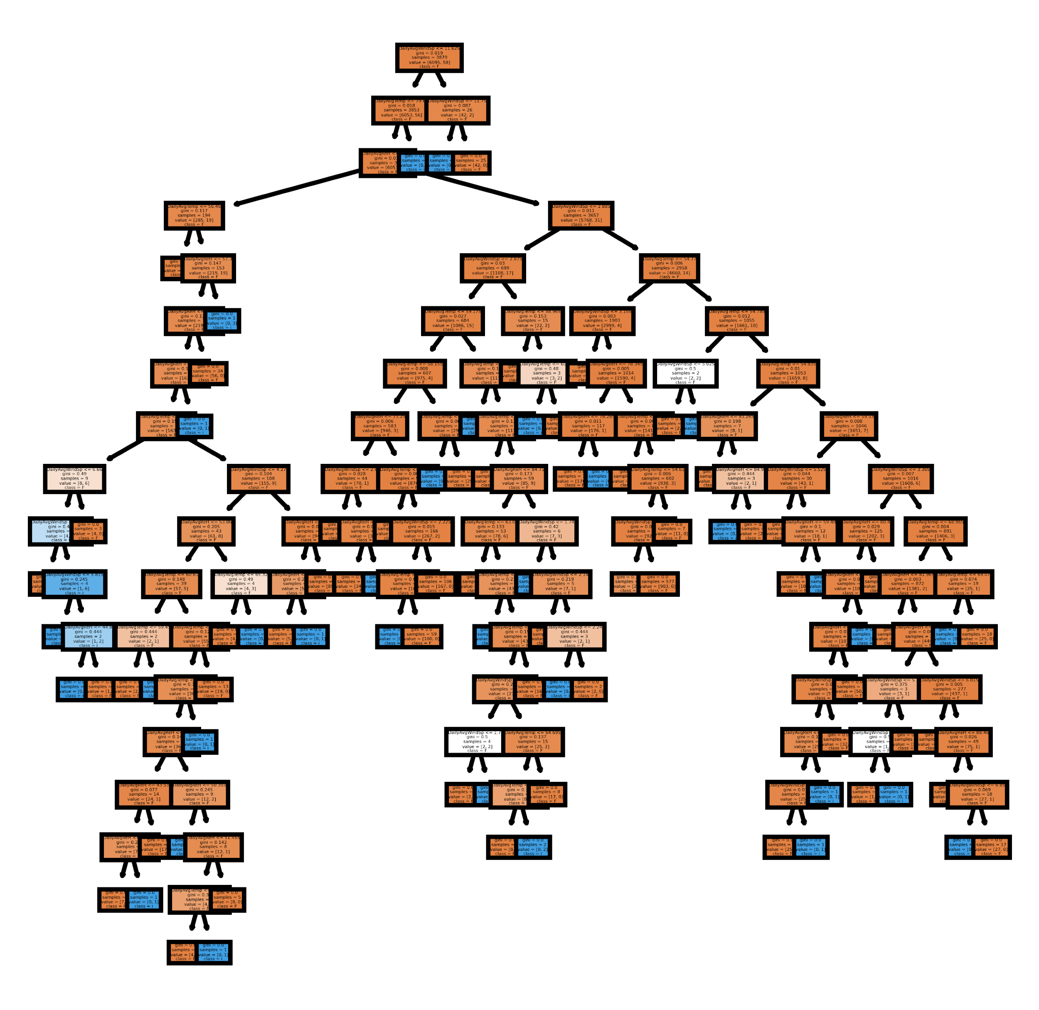

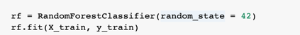
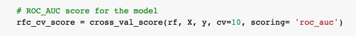
Weather - Random Forest Classifier (RFC)
RFC Model 1: Baseline
Note:
The default value of n_estimators is 1000 in baseline model.
The maximum depth of the tree is None in baseline model.
If None, then nodes are expanded until all leaves are pure or until all leaves contain less than min_samples_split samples.
Figure 1: RFC Model 1- Baseline
Notes:
FireEvents = 0 (No Fire): 9080 cases
FireEvents = 1 (Fire): 104 cases
Note: X = features data, y = target/label data
Model Selection - RFC
Random Forest Classifier (RFC): Ensemble learning method based on classification. It is a collection of many decision trees “randomly selected subset of training set. It aggregates the votes from different decision trees to decide the final class of the test object” and hence is also referred to bootstrap aggregation or bagging technique.
Justification of Model Selection
Bagging is a technique to reduce variance of model with high-variance, such as DTs. Bagging is used to reduce the complexity of the models that overfit the training data (high variance and low bias)
As this model creates different decision trees, it does not return the same result. It returns the value which has better accuracy through the committee (majority voting) system of trees.
The ensemble model ends up outperforming any individual DT’s output as DT models are prone to overfitting the data.
This model has a high tolerance for over-fitting problems if the tree number increases.
RFC is good to apply on large datasets, without affecting accuracy too much.

Slide 13
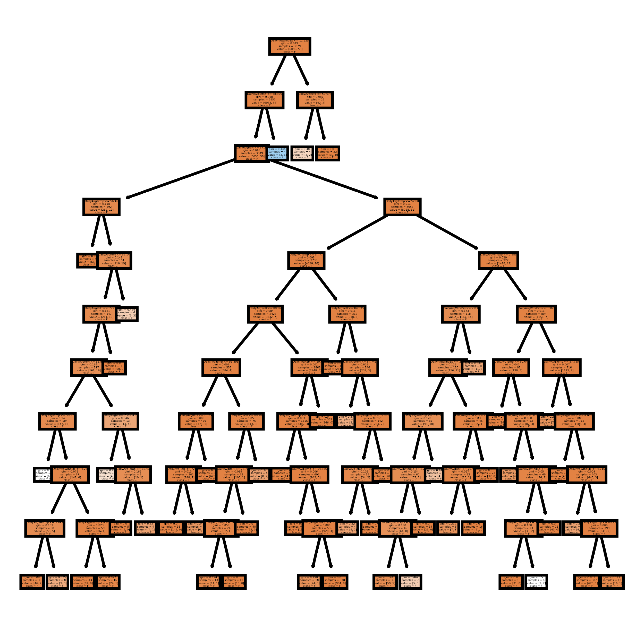
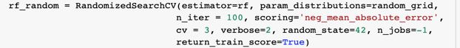
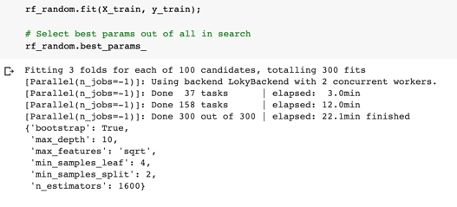
Weather - Random Forest Classifier (RFC)
RFC Model 2: Randomized Search CV
Max_depth has been adjusted to 10; you can see results of RFC in diagram to the right
Figure 2: RFC Model 2- Randomized Search CV
Notes:
FireEvents = 0 (No Fire): 9080 cases
FireEvents = 1 (Fire): 104 cases
Hyper Tuning of the Base Model:
I tuned depending on the classifier of choice, in this case Random Forest Classifier, various hyper-parameters which are responsible for constraining the majority class to take over as I am using Scikit-learn. I used both randomized CV search and grid search for ideal parameters that will yield good mean AUC scores.
I decided to present my results for randomized search CV RFC model because it yielded the best results when compared to grid search RFC model.

Slide 14
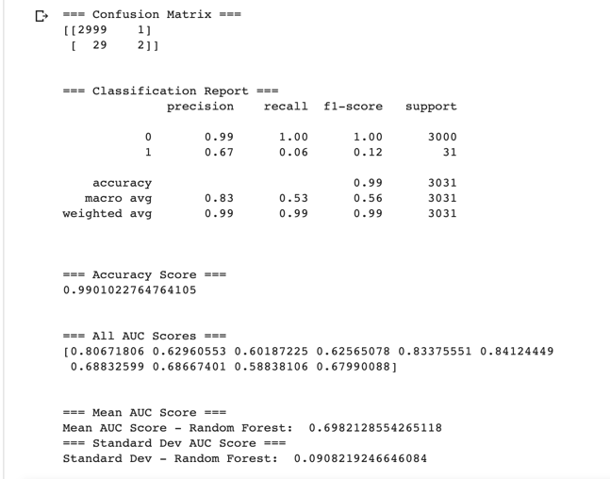
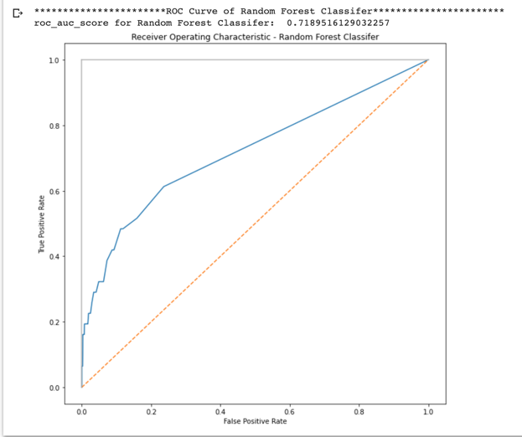
Machine Learning Experimental Results
RFC Model 1: Baseline
Figure 1A: Performance Metrics for base model
Figure 1B: ROC-AUC curve for base model
Notes:
Performance metrics used in evaluating this model include: Classification report, Confusion Matrix, Accuracy score, and Mean AUC score
The roc-auc scoring used in the cross-validation model shows the area under curve of ROC.
The model’s score based on the mean roc-auc score, was .697 and accuracy was around 99%
I selected ROC-AUC metric because accuracy is not useful metric in this case as model seems to be overfitting and we don’t want to fit to single class
The next thing I did was tune rfc parameters to see if we can improve the performance of the model

Slide 15
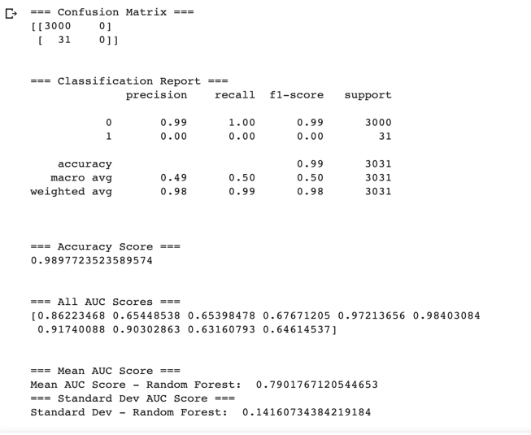
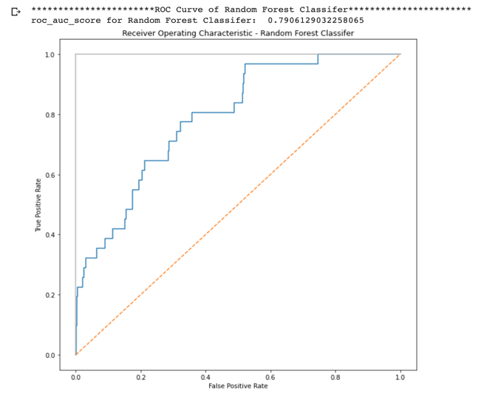
Machine Learning Experimental Results
RFC Model 2: Random CV Search
Figure 2A: Performance Metrics for randomized search CV model
Figure 2B: ROC-AUC curve for randomized search CV model
Notes:
I used both Randomized search CV and Grid search to help me find optimized parameters for my model that will provide good results.
These two slides depict ROC-AUC scores and plots before and after tuning the parameters.
I decided to only show the results of the randomized search CV model as it was much better than the grid search results.

Slide 16

Normalized Difference Vegetation Index (NDVI)
The Normalized Difference Vegetation Index (NDVI) is a numerical indicator that uses the visible and near-infrared bands of the electromagnetic spectrum and is adopted to analyze remote sensing measurements and assess whether the target being observed contains live green vegetation or not.
• NDVI= (NIR-RED) / (NIR+RED)

Slide 17
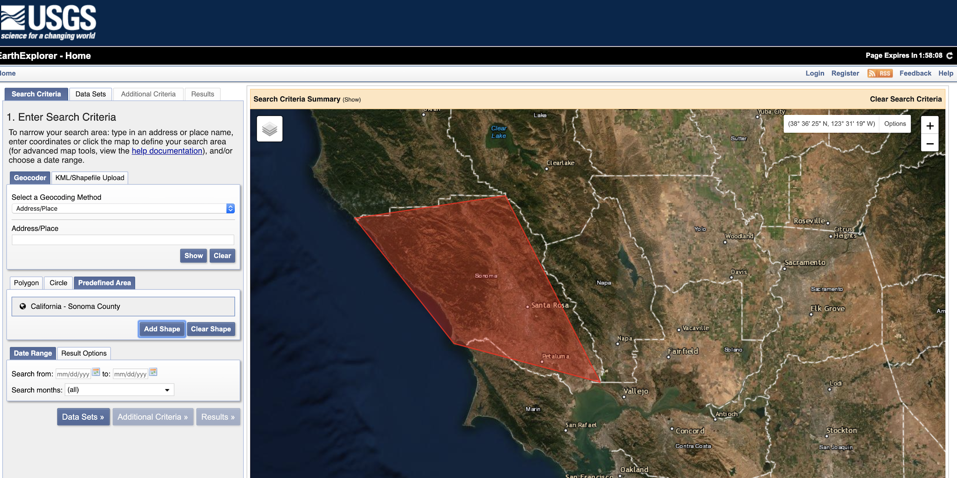
Challenges faced
Identifying the satellite with suitable data
Tried 1: NASA Earth Data
Tried 2: Got csv files that contain land cover parameter only for the land and terrain surface dataset
Tried 3: Emailed Customer Services of Earth Resources Observation & Science Center (EROS) to place the order for the Landsat-8 dataset
Tried 4: Landsat-7 and 8 (United States Geological Survey (USGS) – Earth Explorer remote sensing dataset)
Found that Landsat-7 has all the required data with different band information.
Selected Landsat Analysis Ready Dataset(ARD)-7 Data. Each zip file contains the tif band images and text file. We downloaded all the zip files(80GB) from 1/1/2010 to 12/31/2019. Required band images(tif) accessed with the help of QGIS tool and calculated the NDVI statistics with the help of raster calculator.

Slide 18
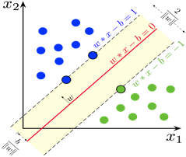
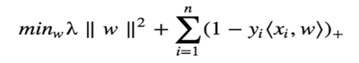
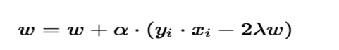

Support Vector machine:
used for both regression and classification tasks. But, widely used for classification objectives.
Objective: To find a hyperplane in an N-dimensional space that distinctly classifies the data points.
Hyperplane that has the maximum margin.
Hyperplanes are decision boundaries that help classify the data points
Support vectors are data points that are closer to the hyperplane and influence the position and orientation of the hyperplane
After adding the regularization parameter, the cost functions:
1.Loss function for SVM
Gradient update:
2. No misclassification
3. Misclassification
where, labelled training set are (xi,yi), w= margin width, alpha = Lagrangian multiplier, lambda = regularization parameter

Slide 19
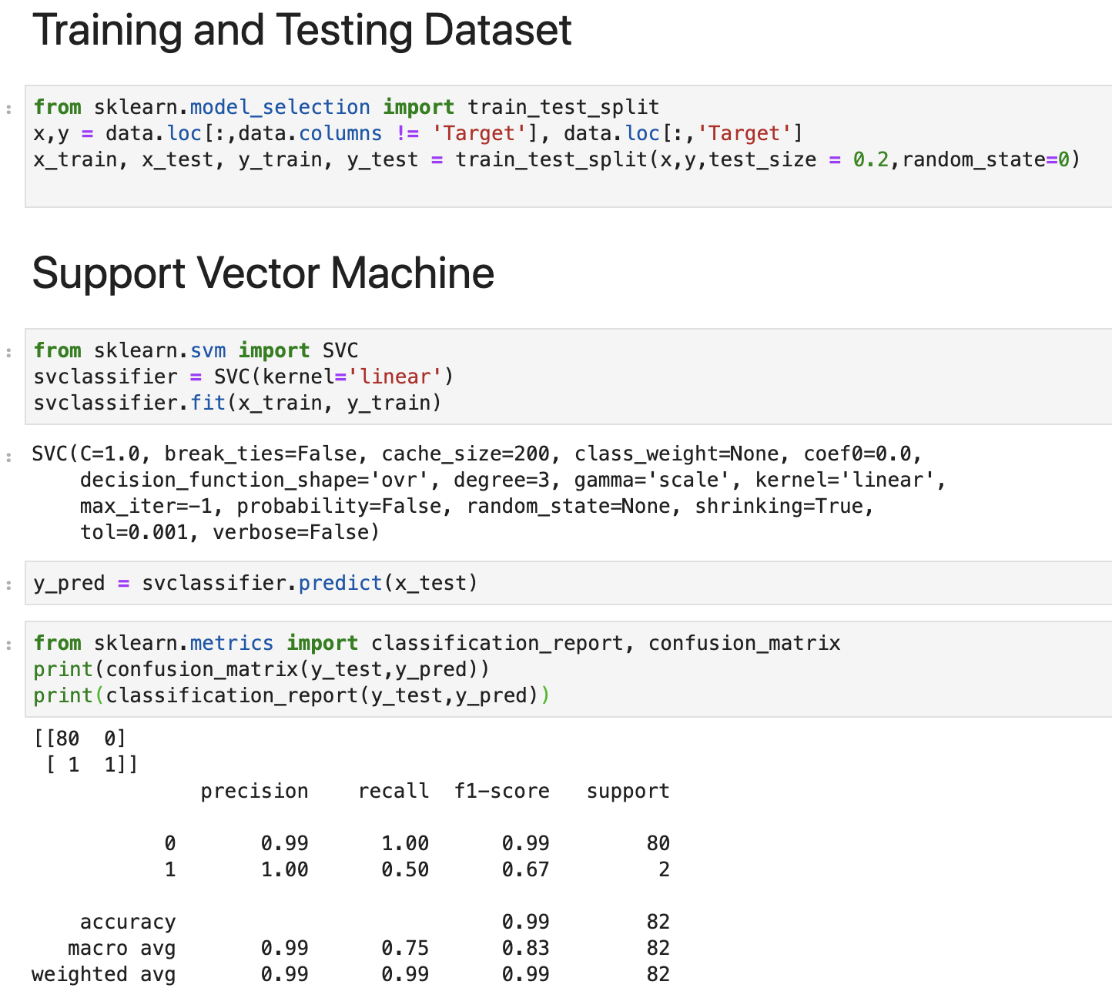
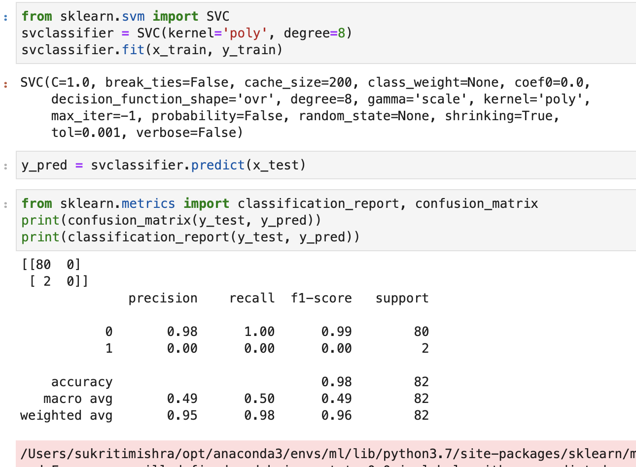
Support Vector machine:
Training and testing data : Accuracy rate:

Slide 20
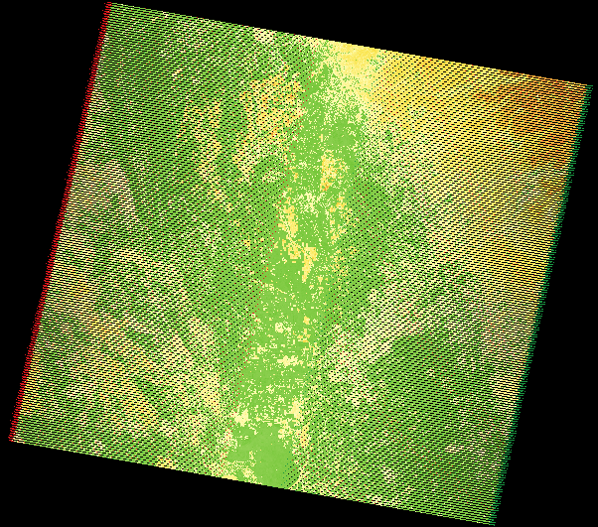
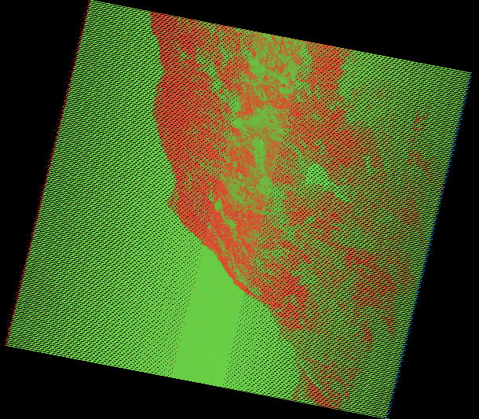
NDVI images:
No Fire Fire

Slide 21
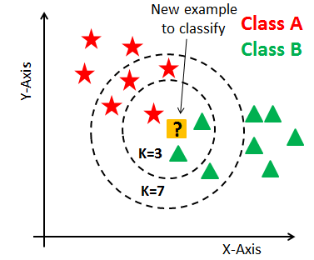
K-Nearest Neighbors (KNN):
K-nearest neighbours is a supervised learning algorithm. It is based on minimum distance (Euclidean distance metric is used) from the query instance to the training samples to determine the k- nearest neighbours. After determining the k nearest neighbours, we take simple majority of these k nearest neighbours to do the prediction of the query instance. The experiment is carried out by varying the number of neighbours (K= 3, 5, 7)

Slide 22
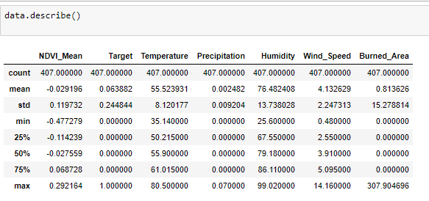
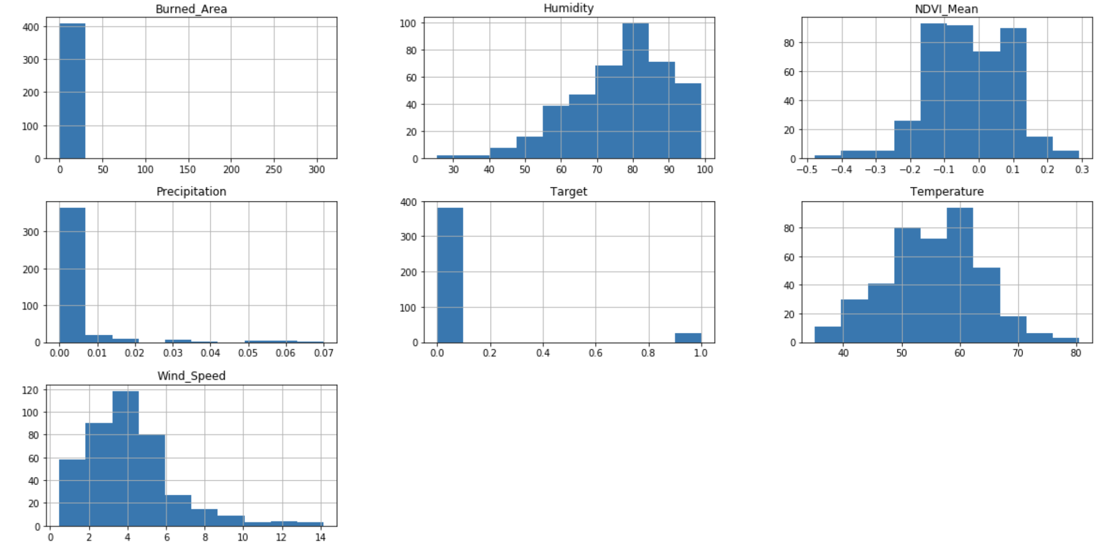
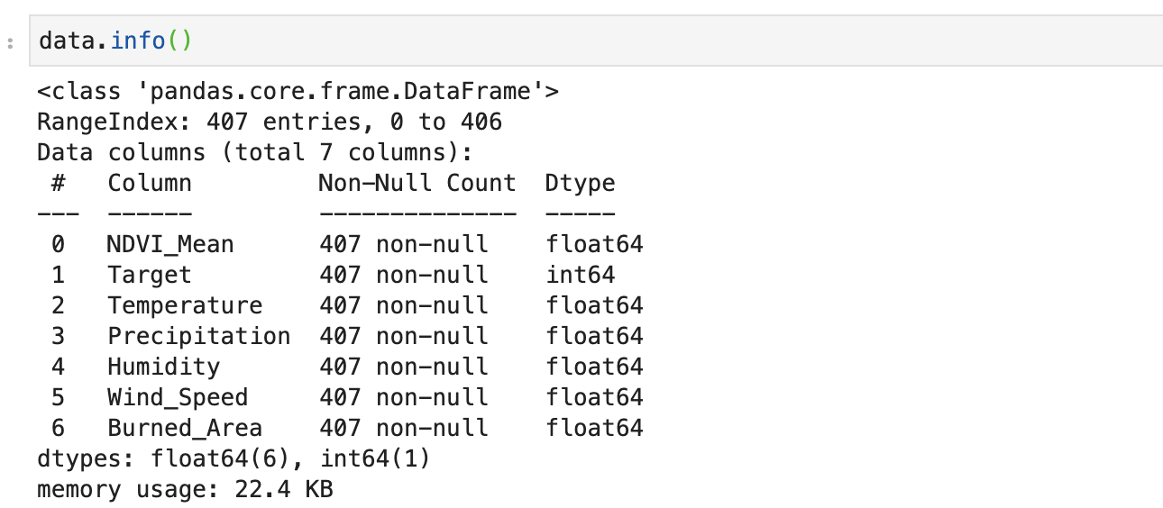
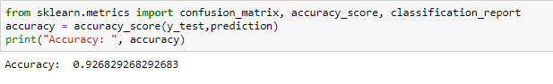
KNN Training and Testing Dataset
About Dataset:
Histogram:
Accuracy rate:

Slide 23
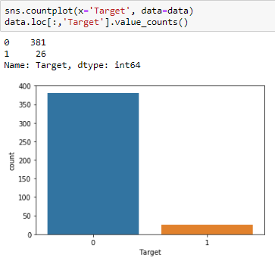
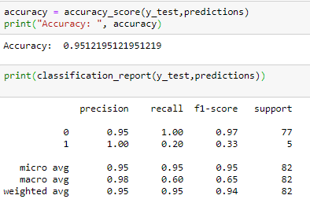
Logistic Regression Testing and Training Dataset
Count of fire and no fire events. 1 represents fire and 0 represents no fire.
Accuracy Rate:

Slide 24
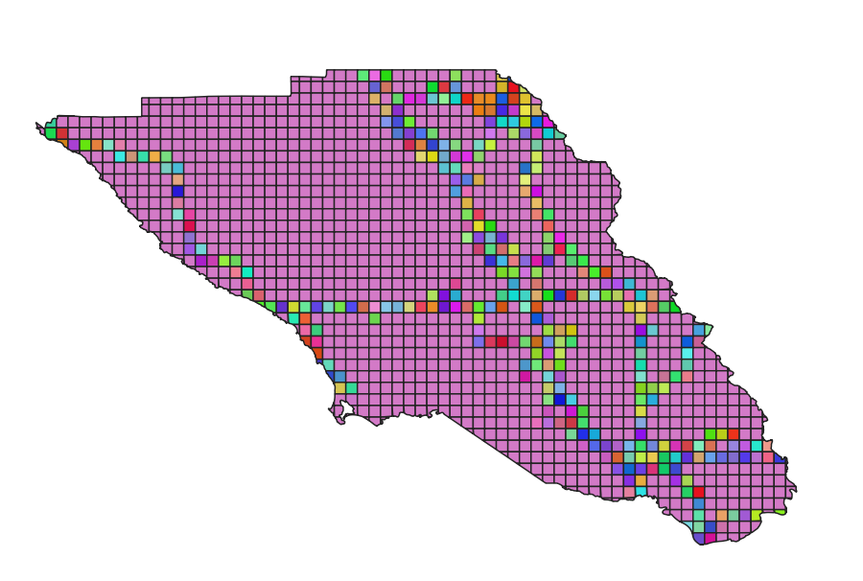
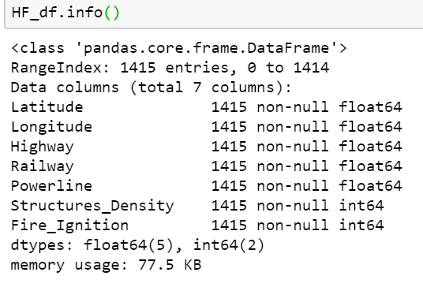
Human Factors - Training Data
Data source:
Shapefiles for highway,powerline,railroad, structures were mapped into a grid of 2kmx 2km on Qgis tool
Cleaning & Preprocessing:
Drop null values & unwanted features
Normalization
Dataset
Features:Latitude, Longitude,Highway line mile, Railway line mile,Powerline line mile, Structures density
Data size: 1414 records
Fire: 229 , No fire: 1186

Slide 25
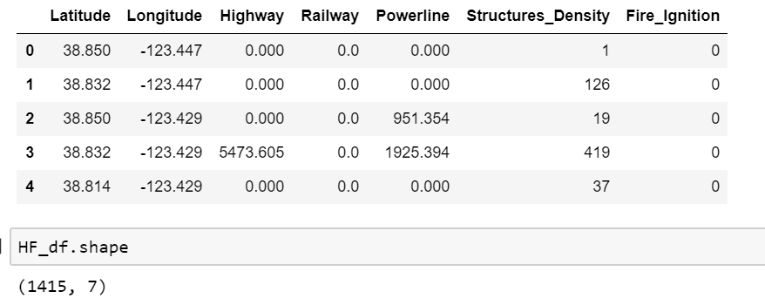
Human Factors - Sample Data

Slide 26
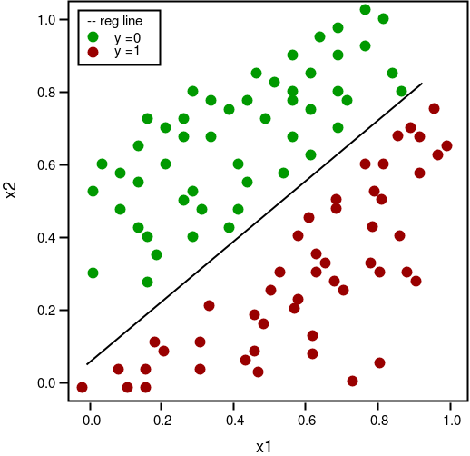
Human Factors - Logistic regression
Logistic regression: is a classification algorithm used to predict the probability of a dependent target variable, which is binary in nature and there would be only two possible classes.
Justification: The goal of this project is to predict fire (1) or no fire (0). Logistic Regression performs well when the dataset is linearly separable and its easier to implement, interpret and very efficient to train.
Fig1 - Binary Logistic regression

Slide 27
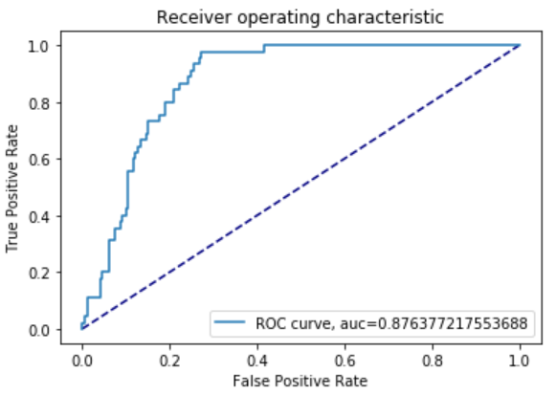
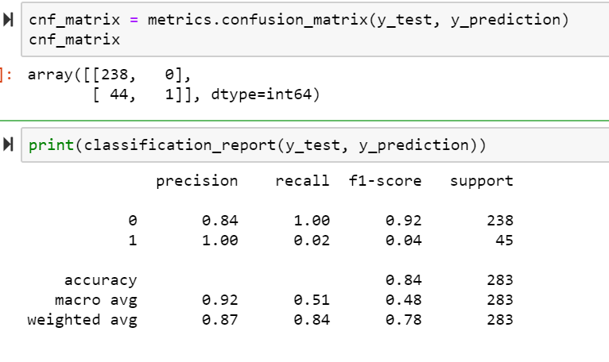

Logistic Regression-Experimental Results
LR- Model 1 : Basic model
Fig 1A- Performance for logistic regression
Fig 1B- ROC-AUC
Fig 1C- Cross Entropy for LG model

Slide 28


Logistic Regression-Experimental Results
LG Model 2- Grid Search CV
Fig 2A - Performance metrics for LG GridSearchCV
Fig 2B - ROC-AUC curve for LG Grid Search CV

Slide 29
Comparison of these experimental results: Logistic, SVM, KNN, and Random Forest
Models for NDVI | Accuracy | F1-Score
Logistic regression | 95% | 94%
Support vector Machine (kernel: polynomial,Gaussian and sigmoid; degree=8) | 98% | 96%
KNN (K=3) | 92% | 90%
Models for Fire history & Weather | Accuracy | F1-Score
Logistic regression (Threshold 90%) | 98.5% | 97.7%
Logistic regression (Threshold 10%) | 97.9% | 97.9%
Model for Fire history and Weather | Accuracy | Mean AUC | Standard deviation AUC
RFC Model 1 Baseline | 99.01% | 0.6982 | 0.0908
RFC Model 2: After Randomized Search CV | 98.97% | 0.7902 | 0.1416
RFC Model 3: After Grid Search | 98.97% | 0.7174 | 0.10417
Models for Human Factors | Accuracy | AUC
Logistic regression | 84% | 0.87
LG Grid Search CV | 84% | 0.88
*Grid Search model results also added for reference
Notes:
10 folds, takes average of each of the 10 rfc auc score and corresponding standard deviation from mean

Slide 30
Thank you

